Slide 1
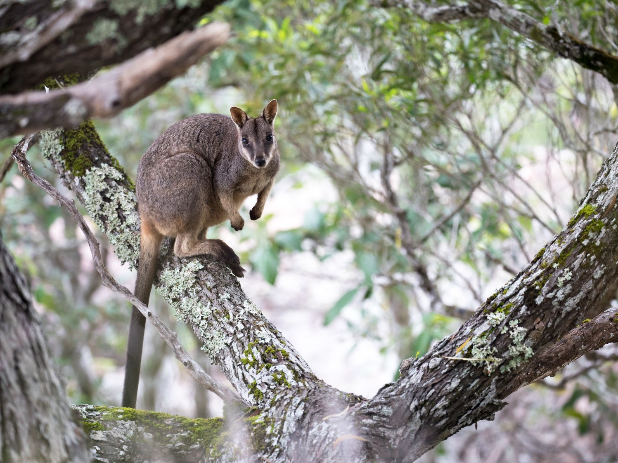
BIOL365: Marine and Terrestrial Ecology
Practical 4: Macroevolutionary questions
James Dorey, Damien Esquerré, and Phil Byrne

Slide 2
Note from last week
Subspecies uploaded to Genbank
Uploaded code under W3 — “4. Align sequences” to remove individuals by name.
Useful for your assignment, no?
Change to phangorn package
phangorn::plotBS
“Bstrees” > became > “trees”
Function to add node support was split…
phangorn::add_support
Changes are normal, but it’s good to be able to deal with them!
Probably comes with years of experience, which you are now starting to get!

Slide 3
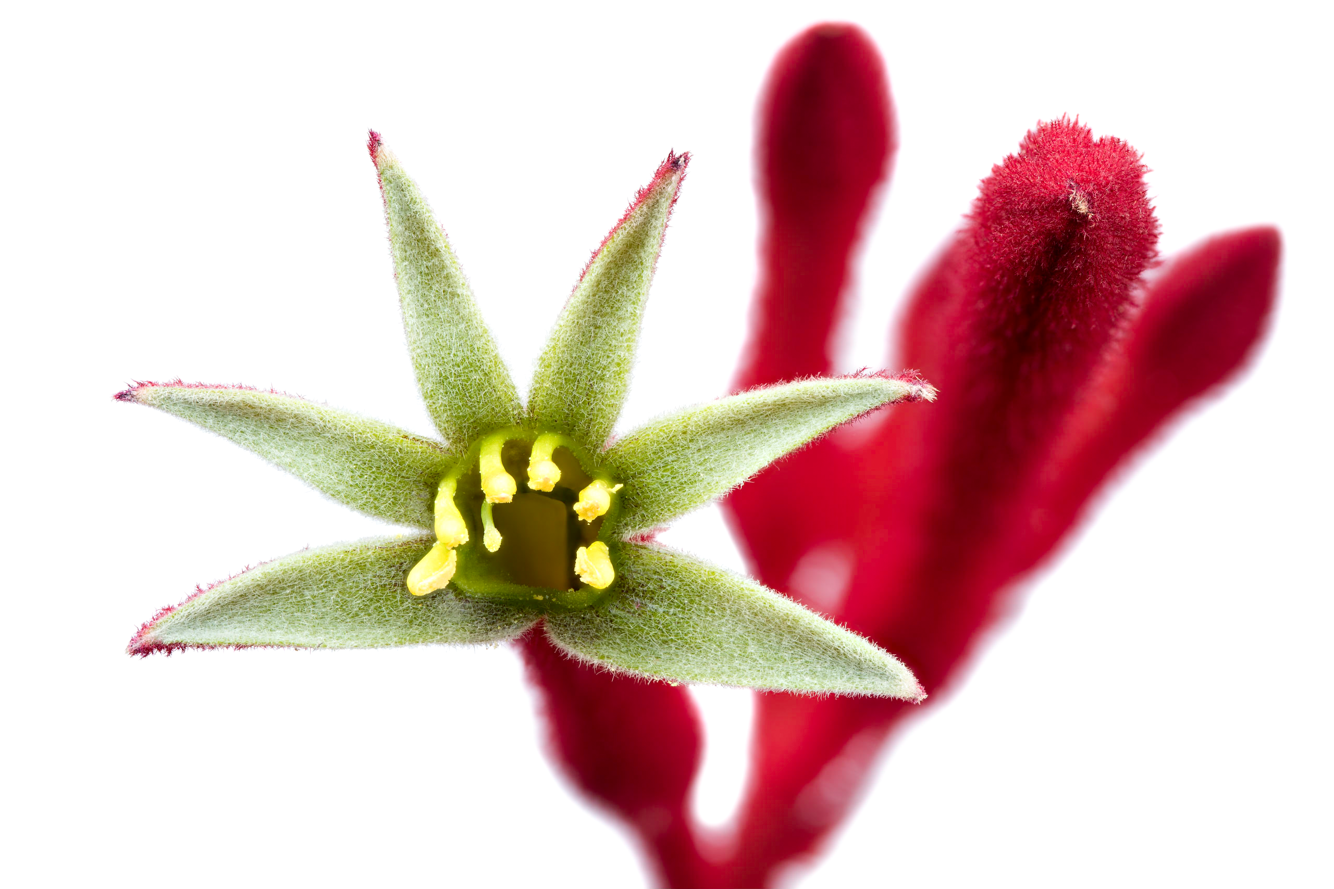
What to expect today
Script preparation
Data management
Genetic data
Trait data
Align the two
Phylogenetically independent contrasts
Ancestral state reconstructions

Slide 4
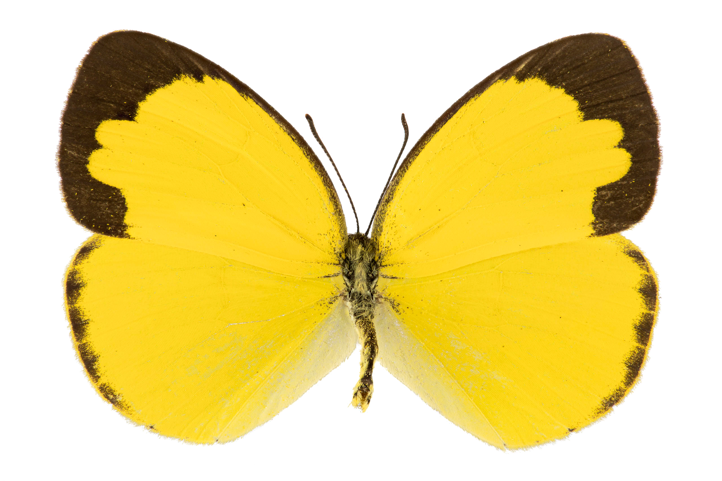
Script preparation
Usually, you will do this every time you open a project
I feel like people are getting more comfortable here

Slide 5
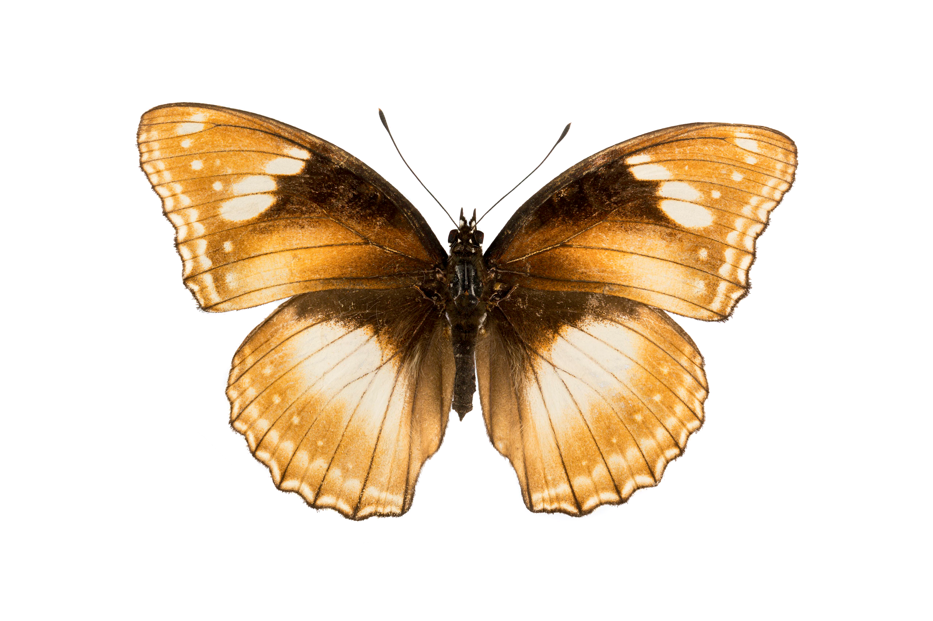
Data management
Using the fasta alignment from last week
A bit more data management magic
Re-make our tree
Read in our trait data!
Make some summaries by finch species
Combine the two datasets
Some VERY useful (and pretty simple) code here

Slide 6
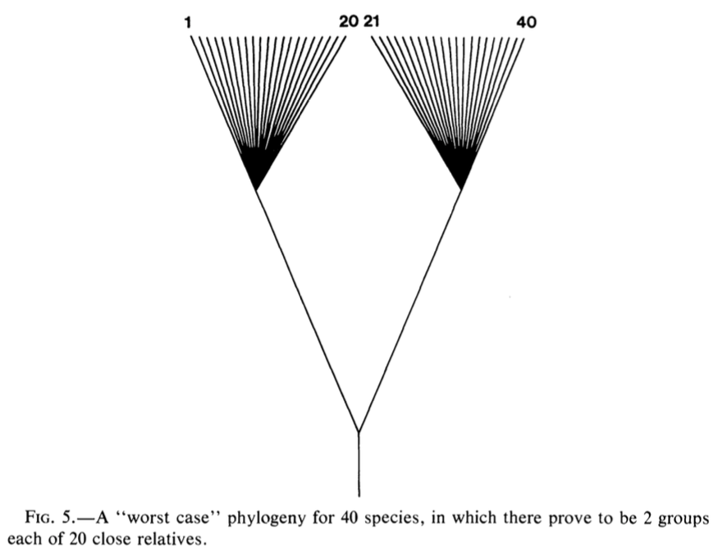
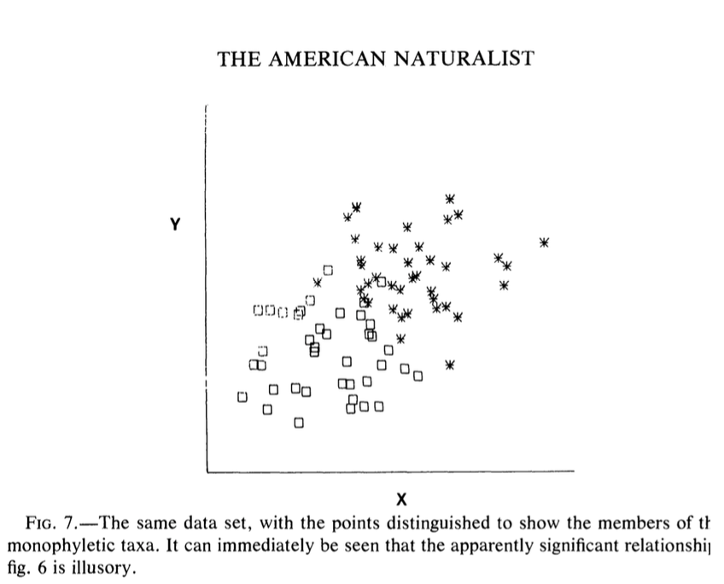
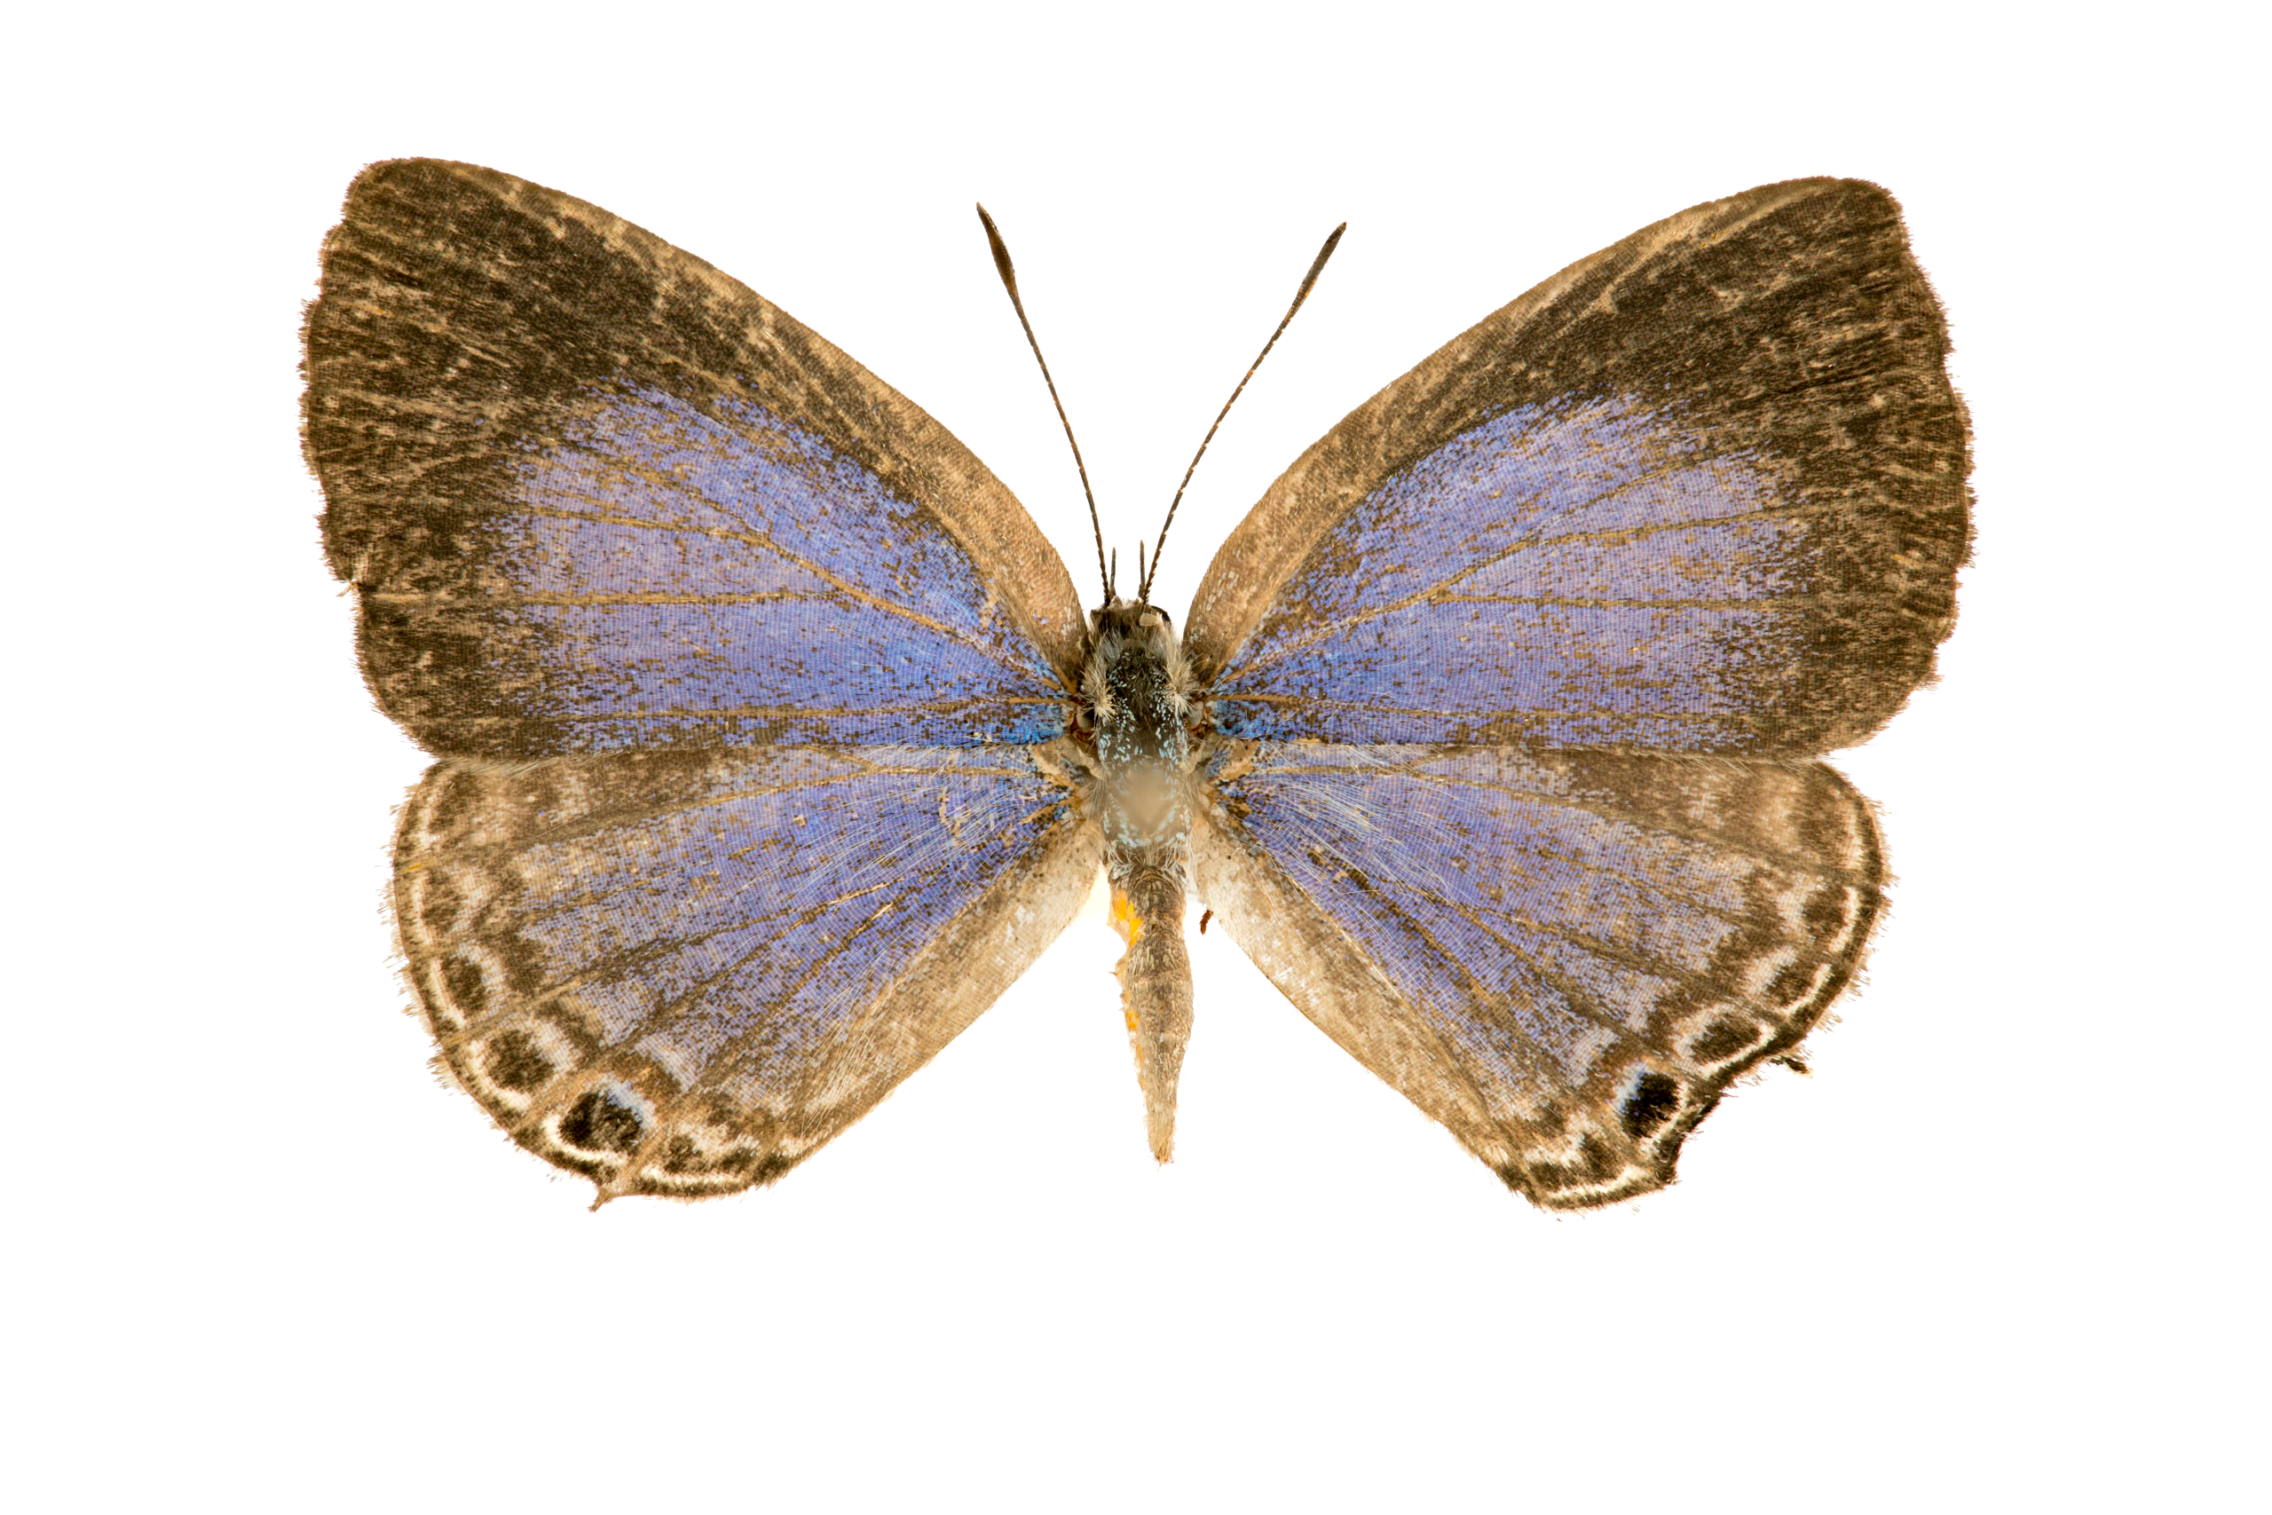


Phylogenetically independent contrasts
Regular regression analysis
Compare with Phylogenetically independent contrasts (PICs)

Slide 7
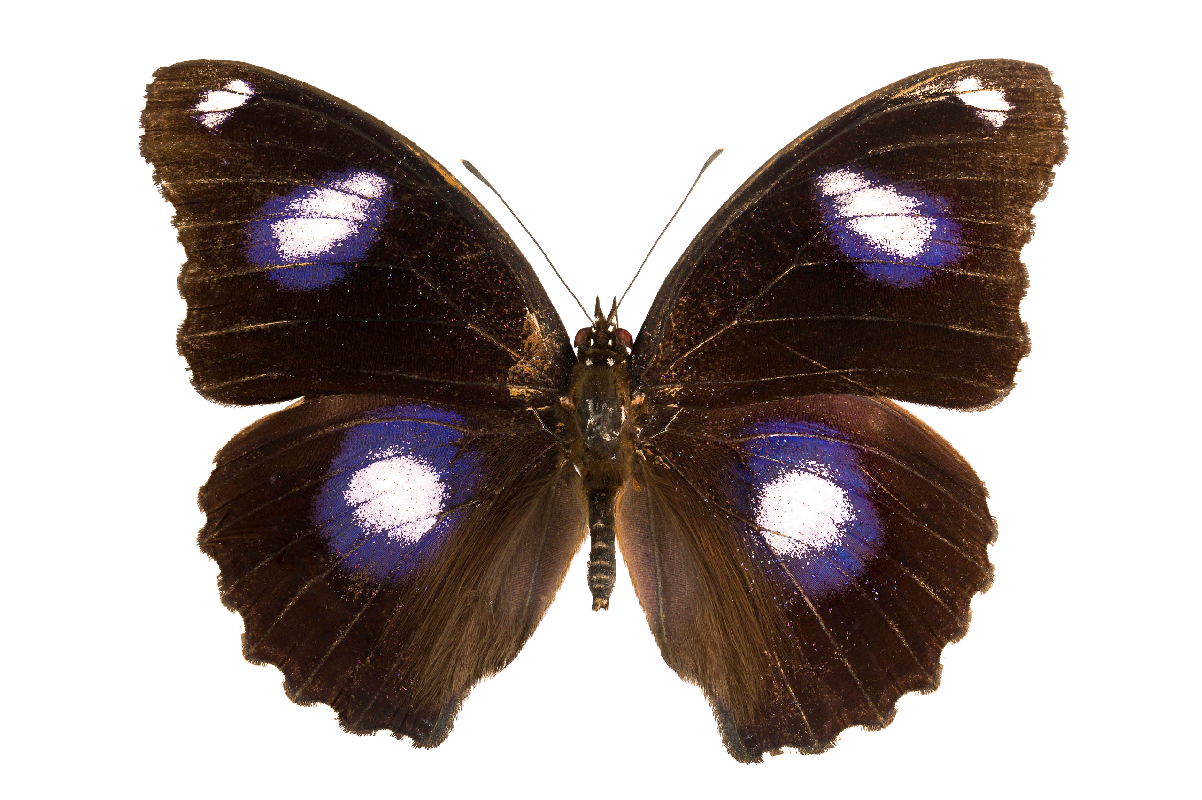
Ancestral states
USE the tree (genetic data) and on that tree…
Infer how a trait has changed
We are not really identifying parts of the gene[ome] associated with triats

Slide 8
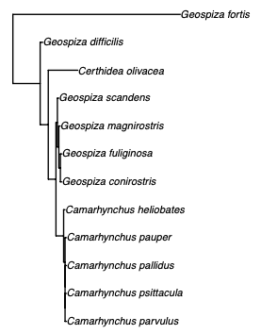
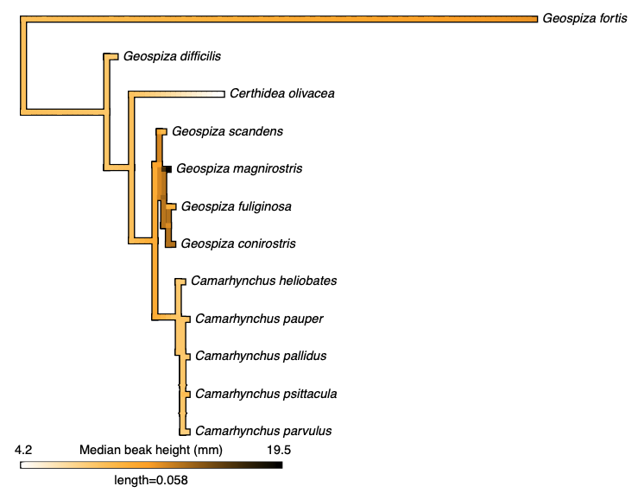
Make a phylogeny
Last week:
This week:

Slide 9
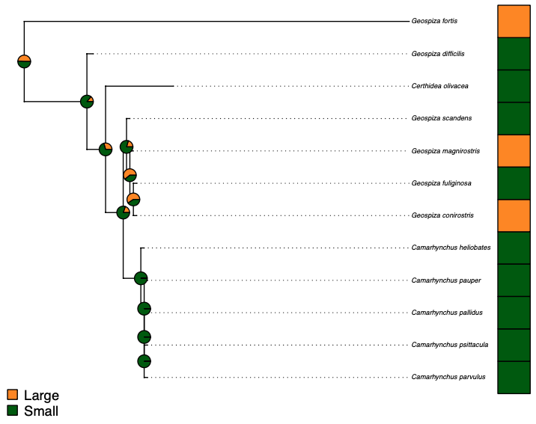
Make a phylogeny
Last week:
This week:

Slide 10
Phylogenetically independent contrasts
Play with the code
Remember, you will need to show independence and problem solving for your assignment!
10% component due midnight Friday after next (Week 6)

Slide 11
Did you finish early?
Help your neighbour
Work on your assignment and seek help or advice (keeping in mind that others doing the prac might need more help)
???
Okay, fine you can go if you’ve checked with your demonstrator

